Slide 1


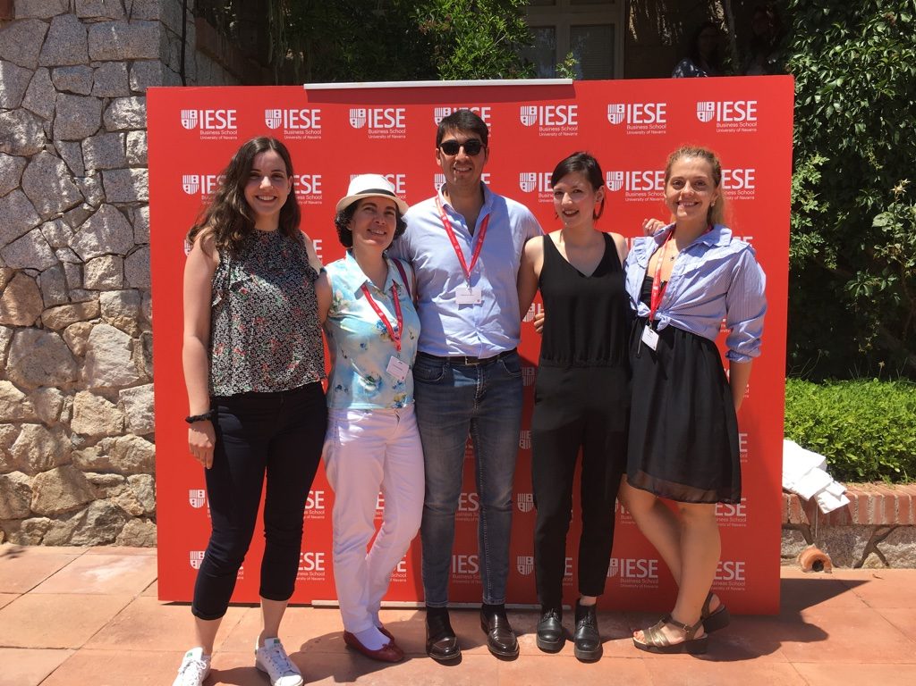
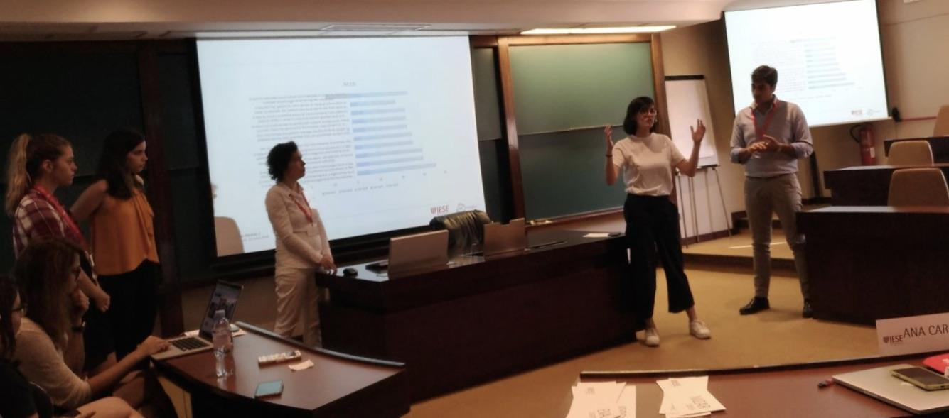




Team2 ‘Care to count’
StarShip Module 3, 10th Sept
Coimbra, Portugal

Slide 2

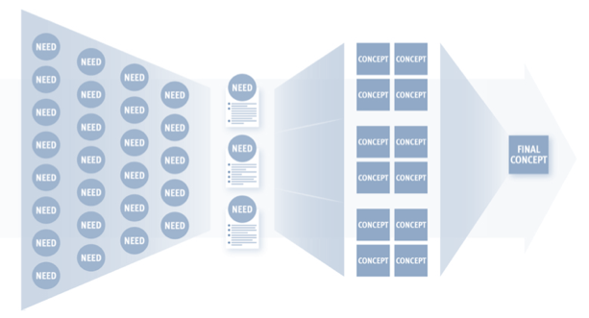
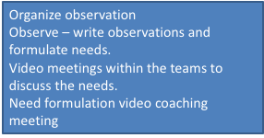




Top 1 need: Care for Counting
A way to improve the experience of counting carbohydrates using minimal cognitive load to improve the motivation for diabetic diet management.

Slide 3
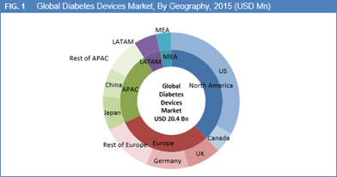
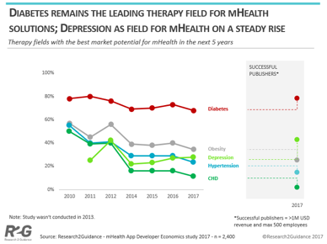
Market analysis

Slide 4
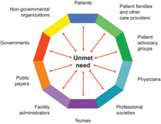
Stakeholder | Personal entity | Impact How much the project impact them | Influence How much influence do they have over the project | Priority What is important to the stakeholders | Contribution How the stakeholders can contribute to the project | Block How the stakeholder can block the project | Engagement strategies
Beneficiary | DM 1 DM2 Gestational diabetes | High | High | Accuracy Fast decision Validation Personalized | Feedback Direct monitoring | Non-participation Age Digital/health literacy Culture Personal traits | Medical staff engagement Educational videos
User | Software developers | High | High | Access to data analytics | New features Interoperability with EHR | Lack of knowledge/ infrastructure/HR | Strategic alliances
Payer | Insurance companies Patients (DM1, DM2) Fitness aware | Medium[JF1] | Medium | Reduce DM complications | Advice/checking status of diabetes management | Culture | Lower the price of infrastucture for patients

Slide 5
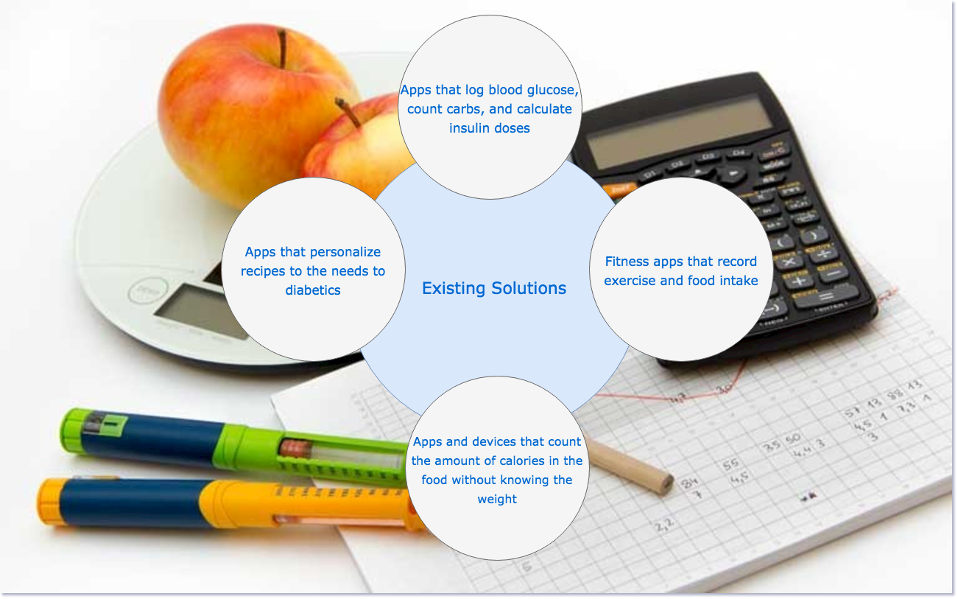

Slide 6


Slide 7
Apps that log blood glucose, count carbs, and calculate insulin does
(mySugr, GlucOracle, Glucos Buddy, BG Monitor, Glooko loogbook, Diabetes Connect)
Existing solutions
Apps that personalize recipes to the need to diabetics
(Carb Counting with Lenny)
Fitness app that record exercise and food intake
(MyFitnessPal ,MyNEtDiary)
Apps and device that count the amount of calories in the food without knowing the weight
(Diabetes: M)

Slide 8
Vestibulum congue
Our Solutions
Vestibulum congue
Vestibulum congue
Vestibulum congue

Slide 9
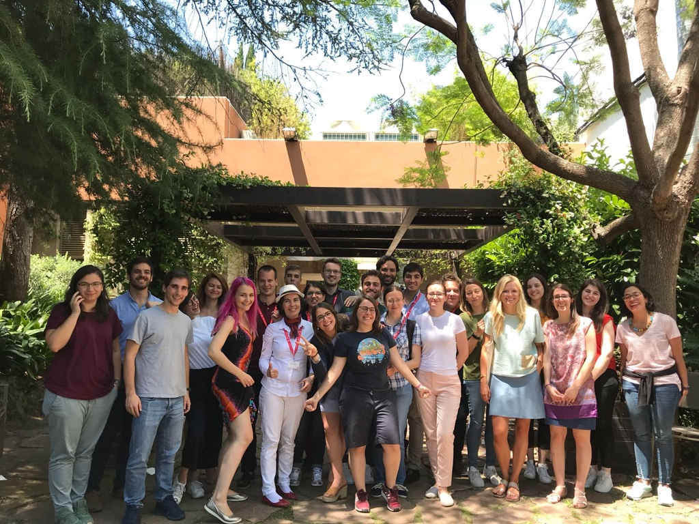
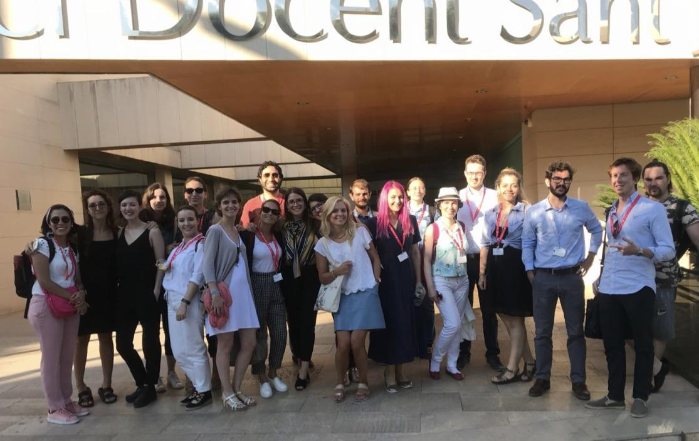
Thank you for the journey so far!

